Slide 1
HW1 guideline
Deep Learning, 2022

Slide 2
OUTLINE
Installation
HW1 guideline

Slide 3

installation(recommended)
Data science toolkit --- Anaconda
With over 25 million users worldwide, the open-source Individual Edition (Distribution) is the easiest way to perform Python/R data science and machine learning on a single machine. Developed for solo practitioners, it is the toolkit that equips you to work with thousands of open-source packages and libraries.
1. Anaconda 3 安裝教學及說明. Python 開發環境介紹 - Anaconda 3 完整安裝說明及步驟 | by Coding Lab | AI for K-12 | Medium
2. Installing Anaconda on Windows & Add Anaconda to Path Tutorial - DataCamp

Slide 4
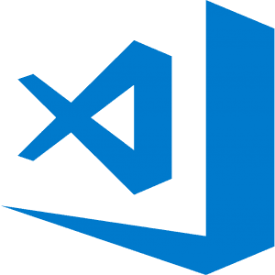


installation
Choose your best Python IDE(integrated development environment)
Visual Studio Code
Spyder
Jupyter Notebook

Slide 5
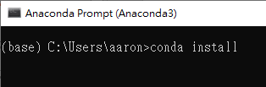

installation
Conda works on your command line interface such as Anaconda Prompt on Windows and terminal on macOS and Linux.
Navigator is a desktop graphical user interface that allows you to launch applications and easily manage conda packages, environments, and channels without using command-line commands.
desktop graphical user interface
command-line

Slide 6
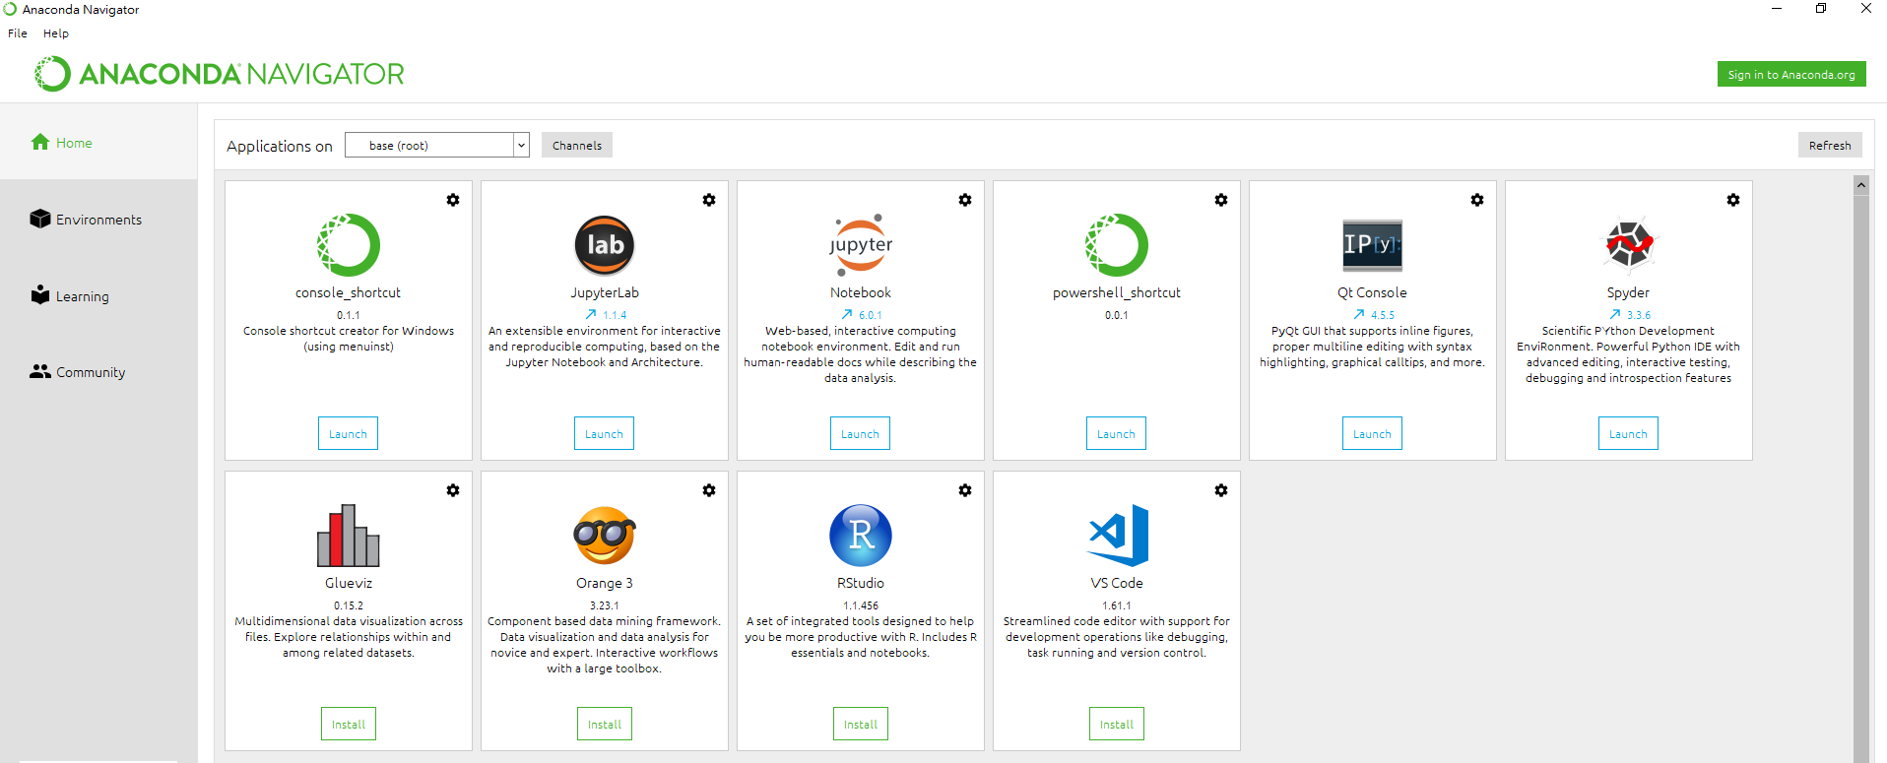
Installation
Install with GUI
Choose one you like most!

Slide 7
Tutorial
Website:
Getting started with Anaconda — Anaconda documentation
Quickstart — Spyder 5 documentation (spyder-ide.org)
Jupyter Notebook介紹及安裝說明 - Python4U – Medium
How to Use Jupyter Notebook in 2020: A Beginner’s Tutorial (dataquest.io)
Video:
1-2. Spyder使用教學，Python編輯器最詳細比較－【行銷搬進大程式】 - YouTube
Basics of SPYDER IDE for Python Programmers - YouTube
0-2.Python Jupyter Notebook 使用教學 - YouTube
Jupyter Notebook Tutorial: Introduction, Setup, and Walkthrough - YouTube

Slide 8

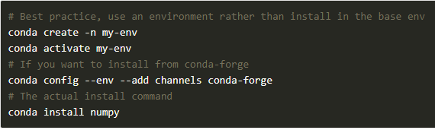
Installation(recommended)
Install Numpy
NumPy is the fundamental package for scientific computing in Python. It is a Python library that provides a multidimensional array object, various derived objects (such as masked arrays and matrices), and an assortment of routines for fast operations on arrays, including mathematical, logical, shape manipulation, sorting, selecting, I/O, discrete Fourier transforms, basic linear algebra, basic statistical operations, random simulation and much more.
Install Numpy with anaconda prompt
NumPy quickstart — NumPy v1.21 Manual

Slide 9
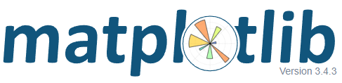
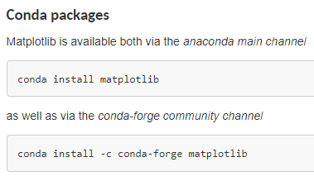
Installation(recommended)
Install matplotlib
Matplotlib is a plotting library for the Python programming language and its numerical mathematics extension NumPy. It provides an object-oriented API for embedding plots into applications using general-purpose GUI toolkits like Tkinter, wxPython, Qt, or GTK. There is also a procedural "pylab" interface based on a state machine (like OpenGL), designed to closely resemble that of MATLAB, though its use is discouraged.[3] SciPy makes use of Matplotlib.
Tutorials — Matplotlib 3.4.3 documentation

Slide 10

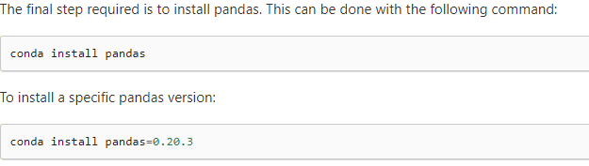
Installation(recommended)
Install pandas
When working with tabular data, such as data stored in spreadsheets or databases, pandas is the right tool for you. pandas will help you to explore, clean, and process your data. In pandas, a data table is called a DataFrame.
10 minutes to pandas — pandas 1.3.4 documentation (pydata.org)

Slide 11
About HW1
In this homework, you are asked to build a deep neural network model by using the Backpropagation and Stochastic Gradient Descent algorithm. You may design the network architecture by yourself, including the number of hidden layers, the number of hidden units, learning rate, the number of epochs and mini-batch size.
Do not use available Machine Learning or Deep Learning packages.

Slide 12
HW1 guildeline - Try to follow these steps:
First, dealing with data:
1.import the data(pandas)
2.shuffle data samples for training and for testing(pandas)
3.one hot encoding(for loop and Numpy)
4.store training sample/label and test sample/label properly(python list and Numpy)

Slide 13
Second, build nn layers(better use functions to modularize your architecture!) :
1.define layer(python function and Numpy)
including weights and biases’ dimension, initial value…
2.define activation function(python function and mathematical operation)
Sigmoid, tanh…
3.define the derivative of your activation function and layer
Derivative of sigmoid and tanh, layer for back-propagation
Make sure you know the difference between np.dot and np.multiply

Slide 14
Third, build nn architecture(better use functions to modularize your architecture!) :
1.define the forward propagation (list, for loop and Numpy)
Implement forward propagation yourself
(How many and what kind of layers you want? Order of these layers? )
Return output value of forward propagation
2.define backward propagation
Implement backward propagation to find the gradient yourself
(derivative of object function, use chain rule to find gradient)
Return gradient
3.define update
How to use gradient to update your weight and bias?(gradient, proper learning rate)
Return new weight and bias
Make sure you know the difference between np.dot and np.multiply!

Slide 15
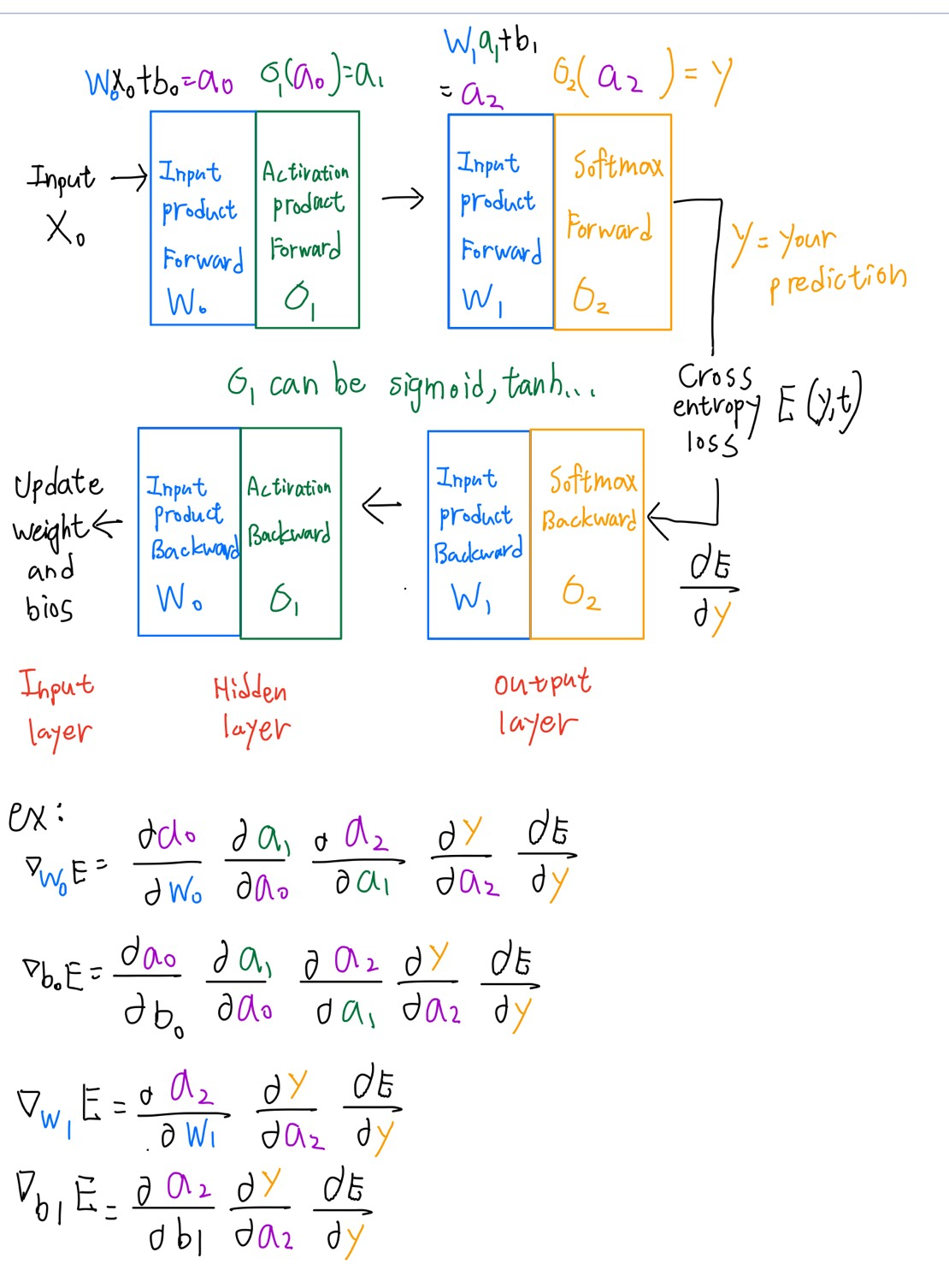
Forward propagation
Take the architecture composed of input layer, hidden layer*1, and output layer as an example.
**Correction**
Note:
The activation function before output
(σ2 in this example) for classification is Softmax, and regression does not require activation function before output.
Back propagation

Slide 16
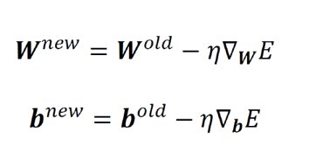
Weight and bias updating
The formulas above is according to the architecture on the previous slide with 2 weights and 2 biases.
(Based on this, the formula for different architectures can be calculated.)

Slide 17
Forth, design training flow(combine your module you define before!)
Define your training process(python function and Numpy),EX:
def train(X, Y, nn_architecture, epochs, learning_rate):
weight, bias = init_layers(nn_architecture)
print('Training parameters:\n epochs = %d learning rate = %f' % (epochs, learning_rate))
for i in range(epochs):
Y_hat, cache = forward_propagation(X.T, weight, bias, nn_architecture)
w_grad, b_grad = backward_propagation(Y_hat, Y, cache, weight, nn_architecture)
weight, bias = update(weight, bias, w_grad, b_grad, nn_architecture, learning_rate)
…

Slide 18
Also remember to calculate your loss while training:
Define your loss function and decide how frequently you want to calculate your loss:
…
print('epoch %d loss : %f’ % (i, your loss function)
…
Finally, Plot your result(matplotlib, or other data visualization toolkit you prefer)
learning curve, training error rate, test error rate

